Slide 1
Entity Relationship Model

Slide 2
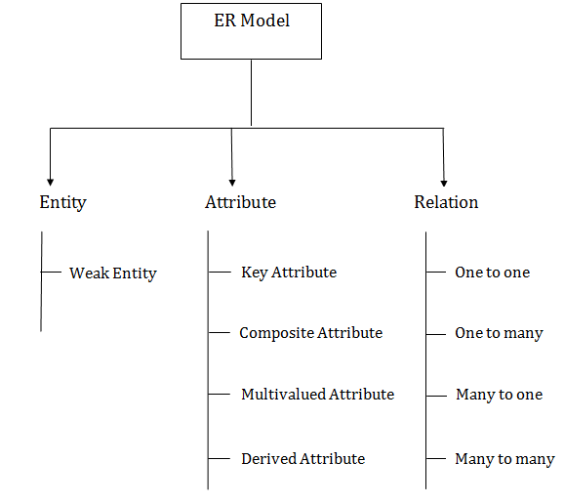
Component of ER Diagram -
Strong Entity

Slide 3
Entity
An entity may be any object, class, person or place.
In the ER diagram, an entity can be represented as rectangles.

Slide 4
Entity set
An entity set is a collection of similar types of entities.
An entity set may contain entities with attribute sharing similar values.
For example,
a Students set may contain all the students of a school.
Lecturer set may contain all the Lecturers of the University from all faculties.

Slide 5
Strong and Weak Entity
An entity set that has a primary key is termed as a strong entity set.
A weak entity is an entity that depends on the existence of another entity.
The weak entity doesn't contain any key attribute of its own.
It uses a foreign key combined with its attributed to form the primary key.

Slide 6
STRONG ENTITY | WEAK ENTITY
The Strong entity has a primary key. | The weak entity has a partial discriminator key.
The Strong entity is independent of any other entity in a schema. | Weak entity depends on the strong entity for its existence.
Strong entity is denoted by a single rectangle. | Weak entity is denoted with the double rectangle.
The relation between two strong entities is denoted by a single diamond simply called relationship. | The relationship between a weak and a strong entity is denoted by Identifying Relationship denoted with double diamond.
Strong entity may or may not have total participation in the relationship. | Weak entity always has total participation in the identifying relationship shown by double line.

Slide 7
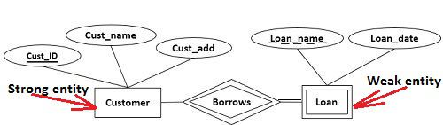
Let us understand this concept with the help of an example; a customer borrows a loan. Here we have two entities first a customer entity, and second a loan entity.

Slide 8
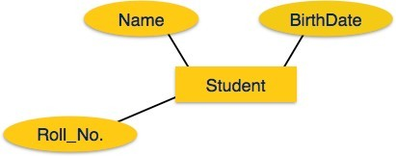
Attributes
Entities are represented by means of their properties, called attributes.
All attributes have values.
For example, a student entity may have name, class,
and age as attributes.
There exists a domain or range of values that can be assigned to attributes.
For example, a student's name cannot be a numeric value. It has to be alphabetic. A student's age cannot be negative, etc.

Slide 9
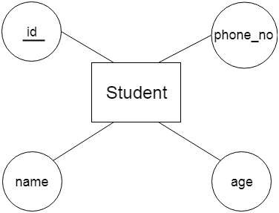
Key Attribute
Key is an attribute or collection of attributes that uniquely identifies an entity among entity set.
The key attribute is represented by an oval shape with the text underlined.

Slide 10
Types of Attributes
Simple attribute
Composite attribute
Derived attribute
Single-value attribute
Multi-value attribute

Slide 11
Simple attribute
Simple attributes are atomic values, which cannot be divided further.
For example, a student's phone number is an atomic value of 10 digits.

Slide 12
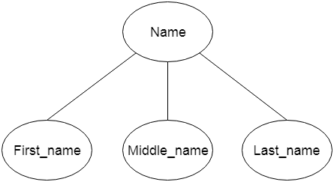
Composite attribute
Composite attributes are made of more than one simple attribute.
or
An attribute that composed of many other attributes is known as a composite attribute.
For example, a student's name may have first_name and last_name.

Slide 13
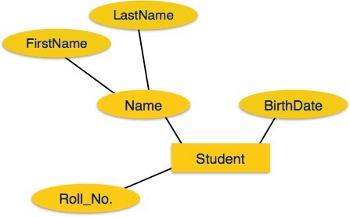
If the attributes are composite, they are further divided in a tree like structure. Every node is then connected to its attribute. That is, composite attributes are represented by ovals that are connected with an ovals.

Slide 14
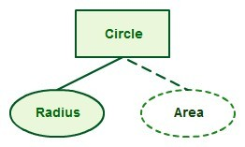
Derived attribute
Derived attributes are the attributes that do not exist in the physical database, but their values are derived from other attributes present in the database.
For example,
average_salary in a department should not be saved directly in the database, instead it can be derived.
For example for a circle the area can be derived from the radius.

Slide 15
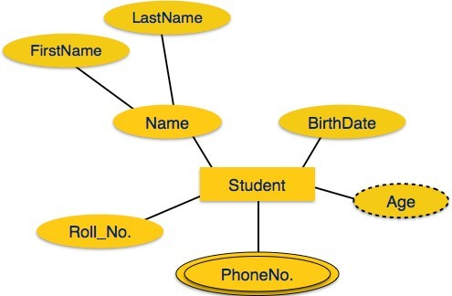
Derived attributes are depicted by dashed oval.

Slide 16

Single-value vs multi-value attribute
Single-value attributes contain single value.
For example − Social_Security_Number.
Multi-value attributes may contain more than one values. For example, a person can have more than one phone number, email_address, etc.
For example a teacher entity can have multiple subject values

Slide 17
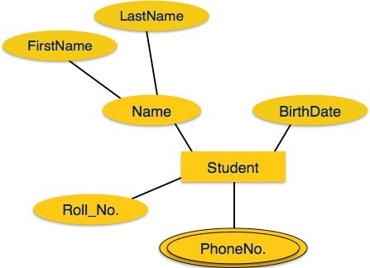
Multivalued attributes are depicted by double oval.

Slide 18
Relationship
The association among entities is called a relationship.
Relationships are represented by diamond shapes and are labeled using verbs. Name of the relationship is written inside the diamond-box.
All the entities (rectangles) participating in a relationship, are connected to it by a line.

Slide 19

Relationship
For example, an employee works_at a department, a student enrolls in a course. Here, Works_at and Enrolls are called relationships.
For example, the entity “carpenter” may be related to the entity “table” by the relationship “builds” or “makes”.

Slide 20
Degree of Relationship
The number of participating entities in a relationship defines the degree of the relationship.
Binary = degree 2
Ternary = degree 3
n-ary = degree n

Slide 21
Mapping Cardinalities
Cardinality defines the number of entities in one entity set, which can be associated with the number of entities of other set via relationship set.
The three common cardinal relationships are:
One-to-one
One-to-many
Many-to-many.

Slide 22
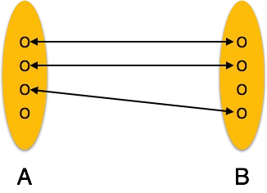
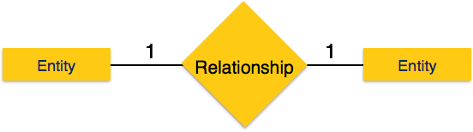
One-to-one
One entity from entity set A can be associated with at most one entity of entity set B and vice versa.
When only one instance of an entity is associated with the relationship, it is marked as '1:1'.
The following image reflects that only one instance of each entity should be associated with the relationship. It depicts one-to-one relationship.

Slide 23
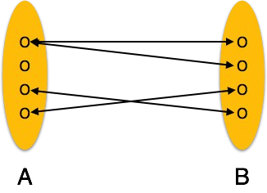
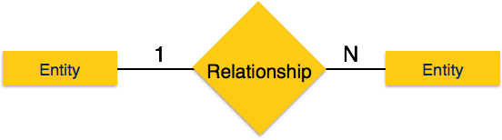
One-to-many
One entity from entity set A can be associated with more than one entities of entity set B however an entity from entity set B, can be associated with at most one entity.
When more than one instance of an entity is associated with a relationship, it is marked as '1:N'.
The following image reflects that only one instance of entity on the left and more than one instance of an entity on the right can be associated with the relationship. It depicts one-to- many relationship.

Slide 24
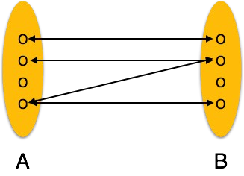
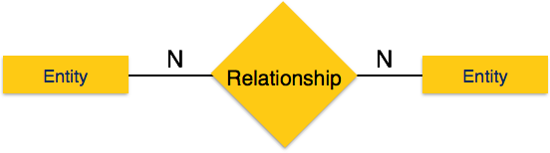
Many-to-many
One entity from A can be associated with more than one entity from B and vice versa.
The following image reflects that more than one instance of an entity on the left and more than one instance of an entity on the right can be associated with the relationship. It depicts many-to-many relationship.

Slide 25
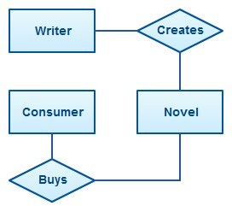
Entity Relationship Model
An Entity Relationship Diagram (ERD) is a visual representation of different data using conventions that describe how these data are related to each other.
For example, the elements writer, novel, and consumer may be described using ER diagrams this way:
The elements inside rectangles are called entities while the items inside diamonds denote the relationships between entities.

Slide 26

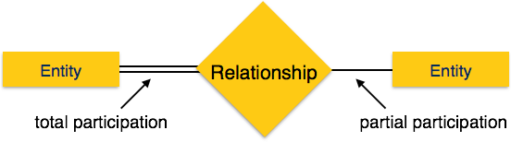
Total Participation − Each entity is involved in the relationship. Total participation is represented by double lines.
Partial participation − Not all entities are involved in the relationship. Partial participation is represented by single lines.

Slide 27
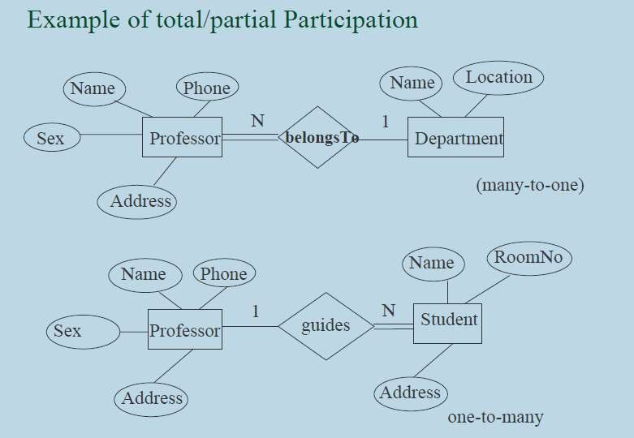

Slide 28

Recursive Relationships
Recursive relationship: An entity set relating to itself gives rise to a recursive relationship

Slide 29
Consider the student record keeping system; there are STUDENT, SUBJECT, DEPARTMENT, COURSE and HEADS.
Also the student study subjects and student register for courses and so on.
First we identify three entities STUDENT, SUBJECT and COURSE and the relationship between STUDENT and COURSE on the one hand and STUDENT and SUBJECT on the other hand.
ER Diagrams for these is shown in the following figures:

Slide 30
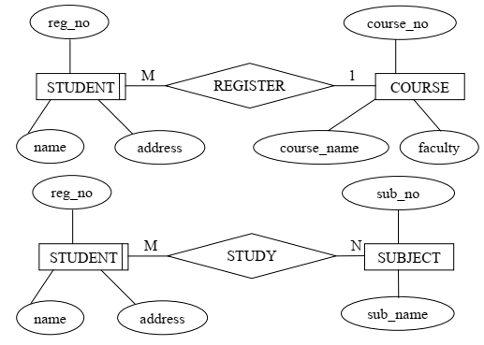

Slide 31
STUDENT participation in the REGISTER relationship is obligatory, since a student must register for a course.
Participation of the entity COURSE in the relationship is non- obligatory, since it might be the case that no students register for a course.
For the STUDY relationship STUDENT is obligatory, since a student must study some subjects, but there may be the case that a subject may not be studied by any student.
Hence the participation of the entity SUBJECT in the relationship is nonobligatory.

Slide 32
We can add a relationship between COURSE and SUBJECT named CONSIST_OF. Some subjects, hence the course is obligatory in this relationship and each subject must be the component of some courses, therefore it is also obligatory

Slide 33
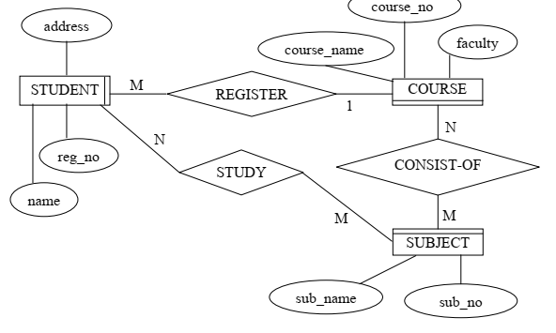

Slide 34
We add DEPARTMENT as an entity and each subject is taught by one department, hence we introduce the relationship TEACHES between SUBJECT and DEPARTMENT entities. The addition of DEPARTMENT on ER Diagram is shown in the figure below:

Slide 35
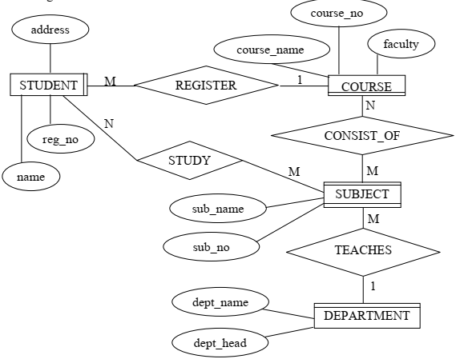

Slide 36
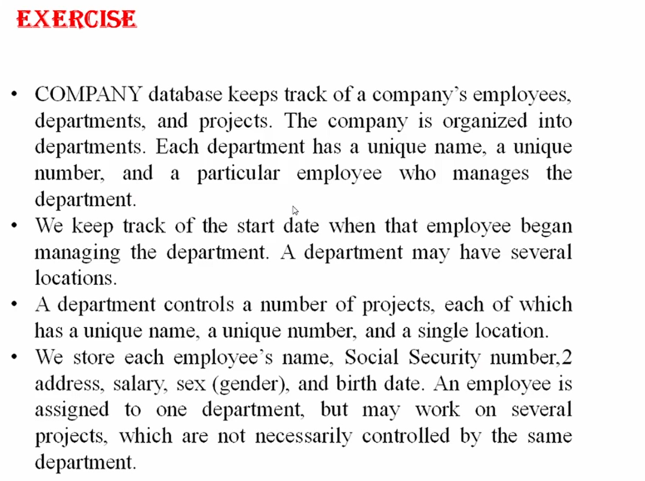

Slide 37
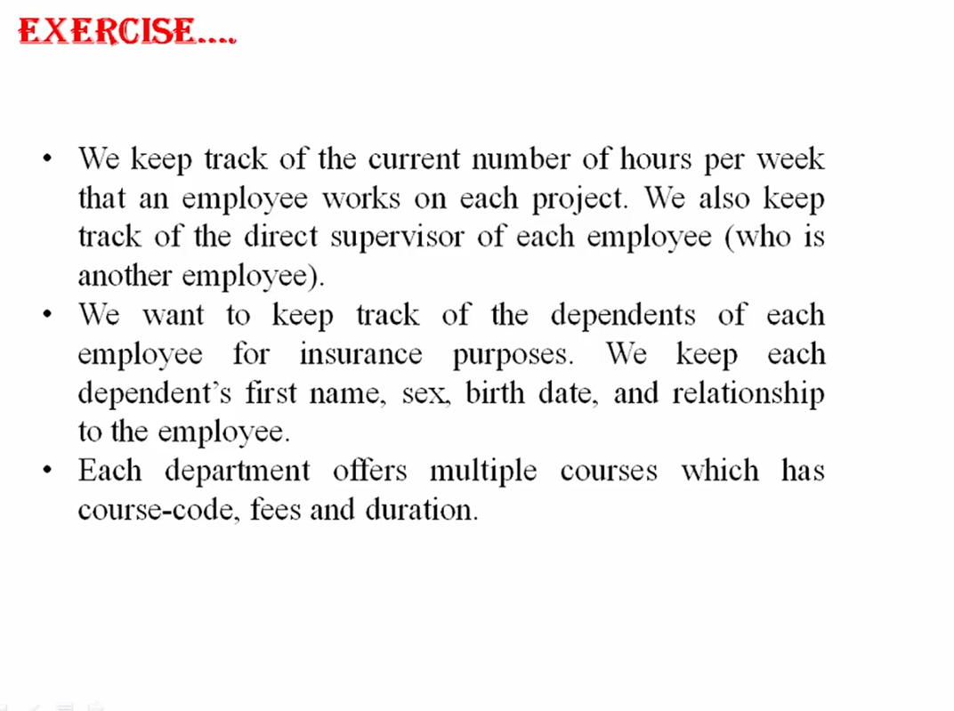

Slide 38
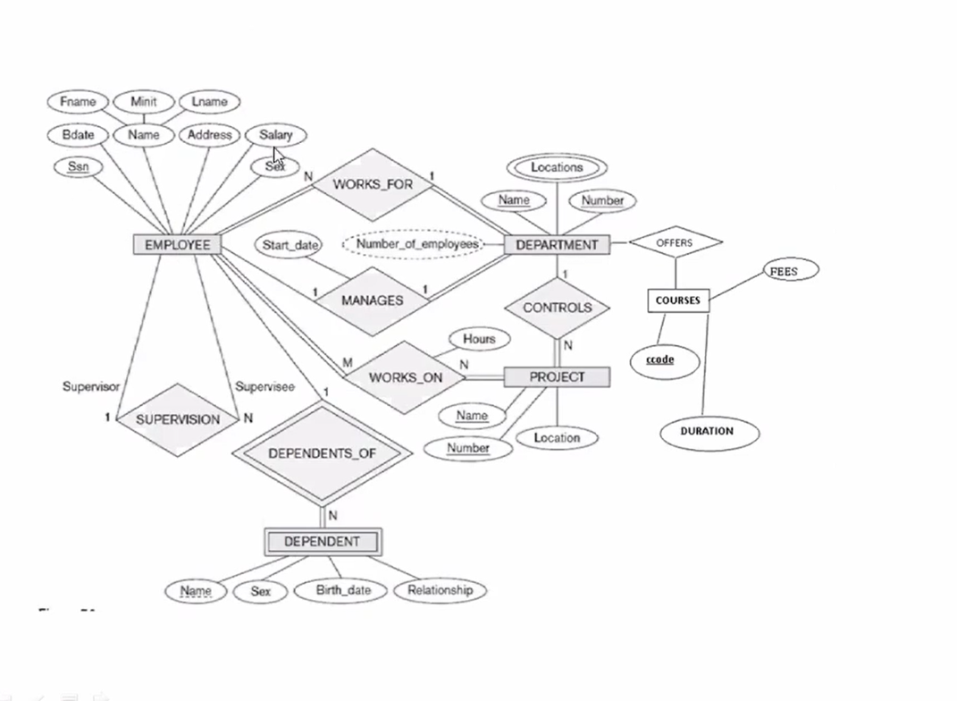

Slide 39
A Simple Example
A company has several departments. Each department has a supervisor and at least one employee. Every supervisor has only one department under him. Employees must be assigned to at least one, but possibly more departments. At least one employee is assigned to a project, but an employee may be on vacation and not assigned to any projects. The important data fields are the names of the departments, projects, supervisors and employees, as well as the supervisor and employee number and a unique project number.

Slide 40
Identify Entities:
A company has several departments. Each department has a supervisor and at least one employee. Every supervisor has only one department under him Employees must be assigned to at least one, but possibly more departments. At least one employee is assigned to a project, but an employee may be on vacation and not assigned to any projects. The important data fields are the names of the departments, projects, supervisors and employees, as well as the supervisor and employee number and a unique project number.

Slide 41
Identified relationships
A Department is assigned an employee.
A Department is run by a supervisor.
An employee belongs to a department.
An employee works on a project.
A supervisor runs a department.
A project uses an employee.

Slide 42
Fill in Cardinality
Supervisor
Each department has one supervisor.
Department
Each supervisor has one department.
Each employee can belong to one or more departments
Employee
Each department must have one or more employees
Each project must have one or more employees
Project
Each employee can have 0 or more projects.

Slide 43
Exercise 1
A university consists of a number of departments.
Each department offers several courses.
A number of modules make up each course.
Students enrol in a particular course and take modules towards the completion of that course.
Each module is taught by a lecturer from the appropriate department, and each lecturer tutors a group of students

Slide 44
Exercise 2
A company database needs to store information about employees (identified by ssn, with salary and phone as attributes), departments (identified by dno, with dname and budget as attributes), and children of employees (with name and age as attributes).
Employees work in departments; each department is managed by an employee; a child must be identified uniquely by name when the parent (who is an employee; assume that only one parent works for the company) is known. We are not interested in information about a child once the parent leaves the company.
Draw an ER diagram that captures this information

Slide 45
Exercise 3
Suppose you are given the following requirements for a simple database for the National Hockey League (NHL):
the NHL has many teams
each team has a name, a city, a coach, a captain, and a set of players,
each player belongs to only one team,
each player has a name, a position (such as left wing or goalie), a skill level, and a set of injury records,
a team captain is also a player,
a game is played between two teams (referred to as host_team and guest_team) and has a date (such as May 11th, 1999) and a score (such as 4 to 2).
Construct a ER diagram for the NHL database

Slide 46
Exercise 4
ANG Laboratory has several chemists who work on one or more projects. Chemists also may use certain kinds of equipment on each project. The organization would like to store the chemist’s employee identification number, his/her name, up to three phone numbers, his/her project identification number and the date on which the project started. Every piece of equipment, the chemist uses, has a serial number and a cost. Also the organization would like to store the date the chemist was assigned to the project and the date an equipment item was assigned to a particular chemist working on a particular project. A chemist must be assigned at least to one project and one equipment item. Any given equipment item need not be assigned, and a given project need not be assigned either a chemist or an equipment item.

